Slide 1
Plan for Tonight’s Office Hours
Show how the TI-83/84 and TI-Nspire can be used to support teaching and learning in Units 7 and 9 of the AP Statistics Course and Exam Description (CED):
Unit 7: Inference for Quantitative Data: Means
Unit 9: Inference for Quantitative Data: Slopes
Share real-world examples that connect concepts in these units
Review how to get data from a .csv file into the TI-83/84 or TI-Nspire
Answer your questions!

Slide 2
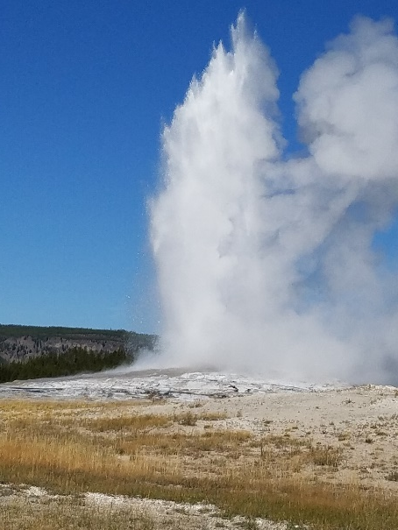
Old Faithful finale
Mr. and Mrs. Starnes returned to Yellowstone National Park (without children) in August 2019. Their primary goal was to see the Old Faithful geyser erupt. When they pulled into the parking lot near Old Faithful, a large crowd of people was headed back to their cars from the geyser. Old Faithful had just finished erupting. It was déjà vu all over again!
1. The Starneses wondered how long they would have to wait for Old Faithful’s next eruption. Prior to the trip, Mr. Starnes collected data on the duration and wait time until the next eruption for a random sample of 80 Old Faithful eruptions in January–August 2019.

Slide 3
Old Faithful finale, Part I
Here are the data on the wait time until the next eruption (in minutes).
(a) Construct and interpret a 90% confidence interval for the mean wait time in the corresponding population of Old Faithful eruptions.
93 | 99 | 88 | 94 | 87 | 97 | 96 | 96 | 99 | 85 | 96 | 100 | 95 | 97 | 100 | 94 | 92 | 93 | 95 | 93
87 | 99 | 101 | 92 | 97 | 92 | 95 | 98 | 90 | 99 | 89 | 97 | 96 | 93 | 90 | 87 | 97 | 96 | 98 | 95
96 | 93 | 89 | 96 | 99 | 87 | 90 | 92 | 98 | 91 | 95 | 86 | 98 | 92 | 98 | 100 | 91 | 92 | 92 | 95
96 | 99 | 95 | 99 | 86 | 100 | 88 | 101 | 98 | 102 | 90 | 86 | 92 | 88 | 102 | 96 | 97 | 96 | 91 | 87

Slide 4
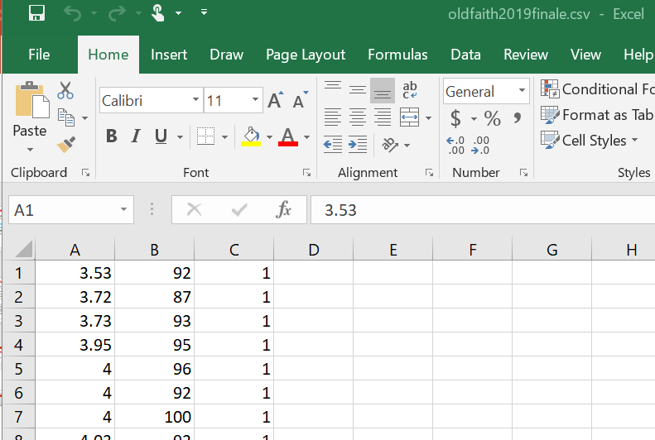
How do you get data from Excel into the TI-84 Plus CE and Smartview?
.csv file with no titles, numeric data

Slide 5
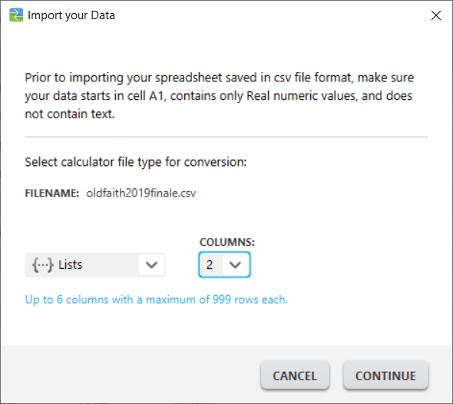
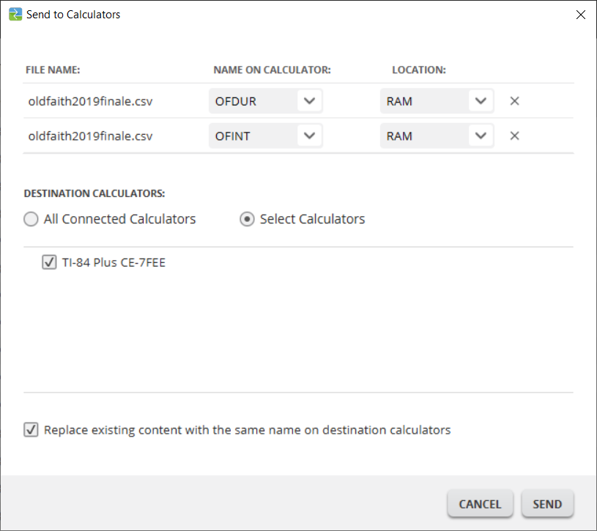
How do you get data from Excel into the TI-84 Plus CE and Smartview?
Up to 6 lists, can use named lists

Slide 6
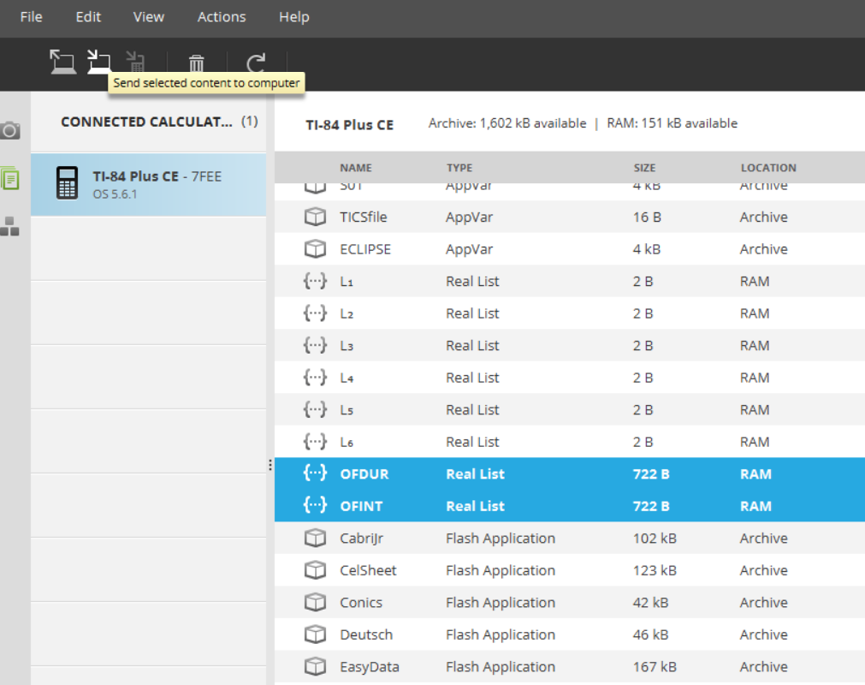
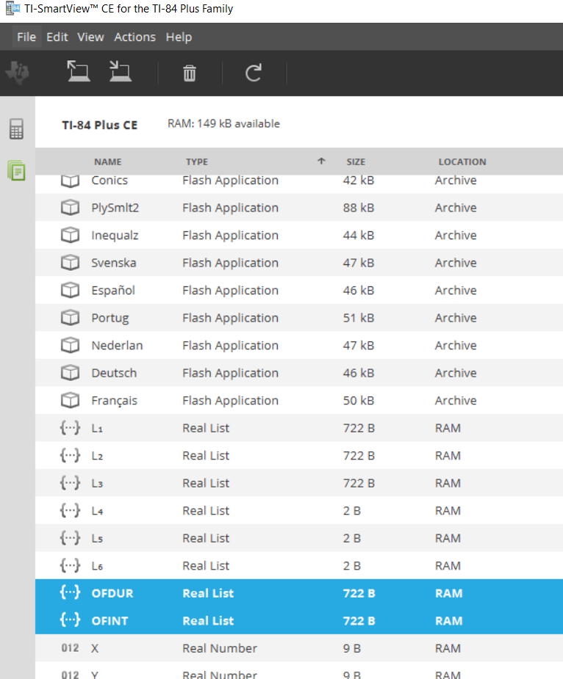
How do you get data from Excel into the TI-84 Plus CE and Smartview?
Once the data are on the calculator, you can send back to the computer and load to Smartview

Slide 7
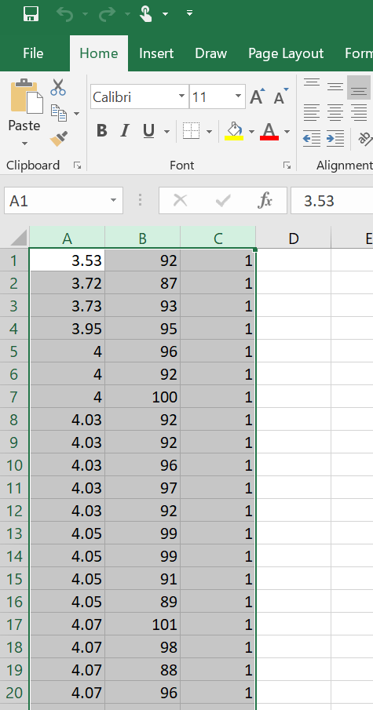
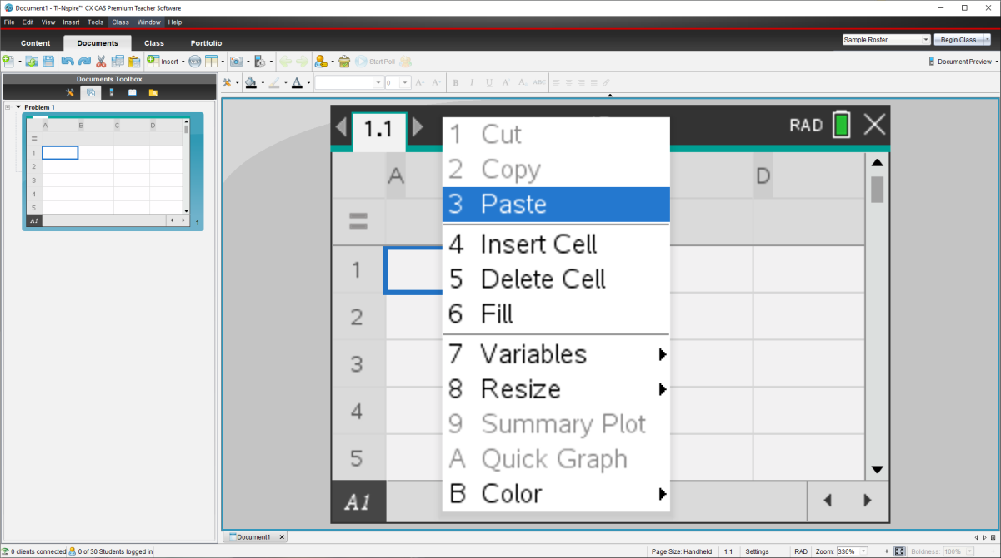
How do you get data from Excel into the TI-Nspire?
Highlight the data in the .csv file, copy the data and paste it into the cells on a lists and spreadsheet page.

Slide 8
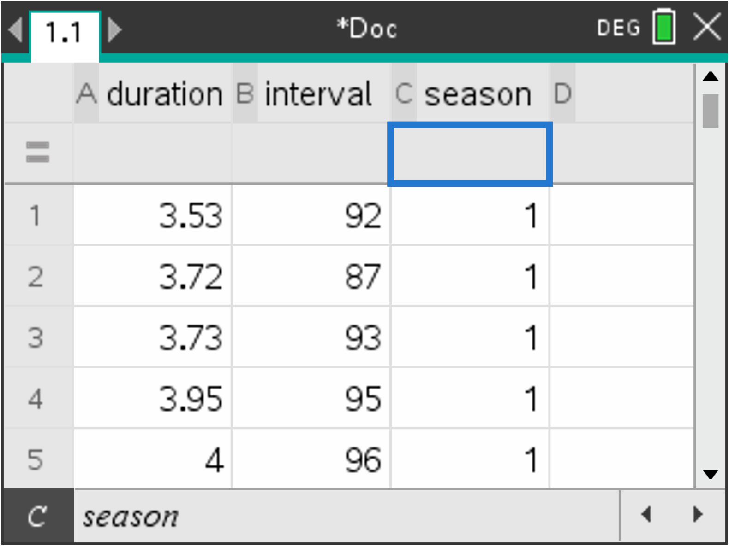
How do you get data from Excel into the TI-Nspire?
Name the lists after pasting in the data.

Slide 9
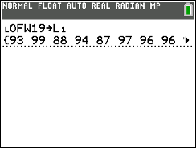
Old Faithful finale, Part I
Here are the data on the wait time until the next eruption (in minutes).
(a) Construct and interpret a 90% confidence interval for the mean wait time in the corresponding population of Old Faithful eruptions.
93 | 99 | 88 | 94 | 87 | 97 | 96 | 96 | 99 | 85 | 96 | 100 | 95 | 97 | 100 | 94 | 92 | 93 | 95 | 93
87 | 99 | 101 | 92 | 97 | 92 | 95 | 98 | 90 | 99 | 89 | 97 | 96 | 93 | 90 | 87 | 97 | 96 | 98 | 95
96 | 93 | 89 | 96 | 99 | 87 | 90 | 92 | 98 | 91 | 95 | 86 | 98 | 92 | 98 | 100 | 91 | 92 | 92 | 95
96 | 99 | 95 | 99 | 86 | 100 | 88 | 101 | 98 | 102 | 90 | 86 | 92 | 88 | 102 | 96 | 97 | 96 | 91 | 87
90% CI for μ = mean wait time in the population of Old Faithful eruptions in January–August 2019
One-sample t interval for a mean
Random? Random sample of 80 eruptions
10%? 80 ≤ 0.10(all Old Faithful eruptions in Jan-Aug)
Normal/Large Sample? n = 80 ≥ 30

Slide 10
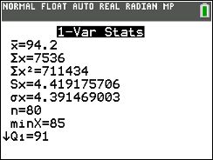
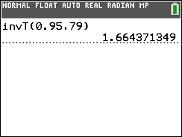
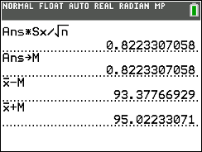
Old Faithful finale, Part I
(a) Construct and interpret a 90% confidence interval for the mean wait time in the corresponding population of Old Faithful eruptions.
CI: statistic ± critical value(standard error of statistic)
$\overline{x}±t^{∗}\frac{s_{x}}{\sqrt{n}}$
= $94.2±1.664\left(\frac{4.419}{\sqrt{80}}\right)$
= $94.2±0.822$
= (93.378, 95.022)

Slide 11
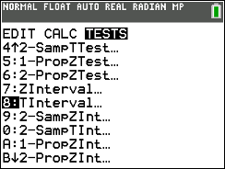
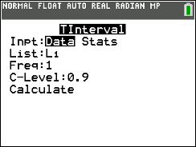
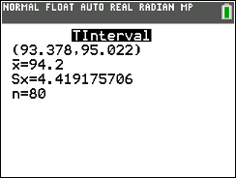
Old Faithful finale, Part I
(a) Construct and interpret a 90% confidence interval for the mean wait time in the corresponding population of Old Faithful eruptions.
CI: statistic ± critical value(standard error of statistic)
$\overline{x}±t^{∗}\frac{s_{x}}{\sqrt{n}}$
= $94.2±1.664\left(\frac{4.419}{\sqrt{80}}\right)$
= $94.2±0.822$
= (93.378, 95.022)
We are 90% confident that the mean wait time in the population of Jan-Aug 2019 Old Faithful eruptions is between 93.378 and 95.022 minutes.

Slide 12
Old Faithful finale, Part I
The National Park Service predicts that the wait time until the next eruption of Old Faithful will be 94 minutes ± 10 minutes. According to the Yellowstone National Park website, this interval is also based on a 90% confidence level.
(b) Following a randomly selected eruption of Old Faithful, is it believable that the wait time until the next eruption will be 100 minutes? Explain your answer.
Yes. The prediction interval for the wait time until the next eruption is 84 minutes to 104 minutes, which includes 100 minutes as a believable value.
(c) Is it believable that the average wait time between Old Faithful eruptions in January-August 2019 was 100 minutes? Justify your answer.
No. The 90% confidence interval for the population mean from part (a) was 93.378 minutes to 95.022 minutes. This interval does not include 100 minutes as a plausible value.
(93.378, 95.022)

Slide 13
Old Faithful finale, part II
2. Mr. Starnes wanted to know if the wait time between Old Faithful eruptions in 2019 was different in the months when more tourists visit the park (June, July, and August) than in the months with fewer visitors (January through May). Here are the data on the wait time until the next eruption (in minutes) for the two groups of months:
Busier months
88 | 94 | 87 | 91 | 86 | 87 | 99 | 85 | 91 | 98 | 99 | 86 | 96 | 96
100 | 97 | 93 | 93 | 100 | 95 | 90 | 96 | 90 | 96 | 98 | 93 | 100 | 90
92 | 92 | 95 | 99 | 95 | 95 | 87 | 98 | 95 | 97 | 96 | 99
Quieter months
92 | 87 | 93 | 95 | 96 | 92 | 100 | 92 | 92 | 96 | 97 | 92 | 99 | 99
91 | 89 | 101 | 98 | 88 | 96 | 99 | 96 | 96 | 90 | 92 | 87 | 86 | 93
97 | 89 | 98 | 88 | 102 | 97 | 94 | 102 | 97 | 101 | 98 | 95
Do these data provide convincing evidence at the α = 0.05 significance level of a difference in the mean wait time for a subsequent Old Faithful eruption in busier and quieter months of 2019?

Slide 14
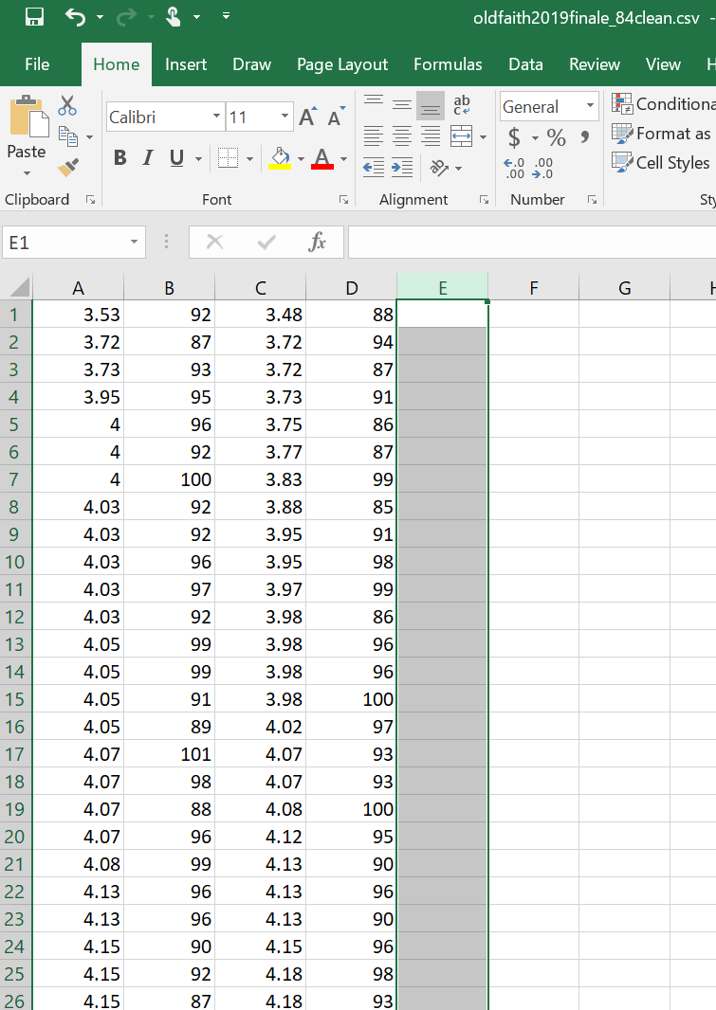
What if the data aren’t TI-84 Plus CE friendly?
Data cleanup

Slide 15
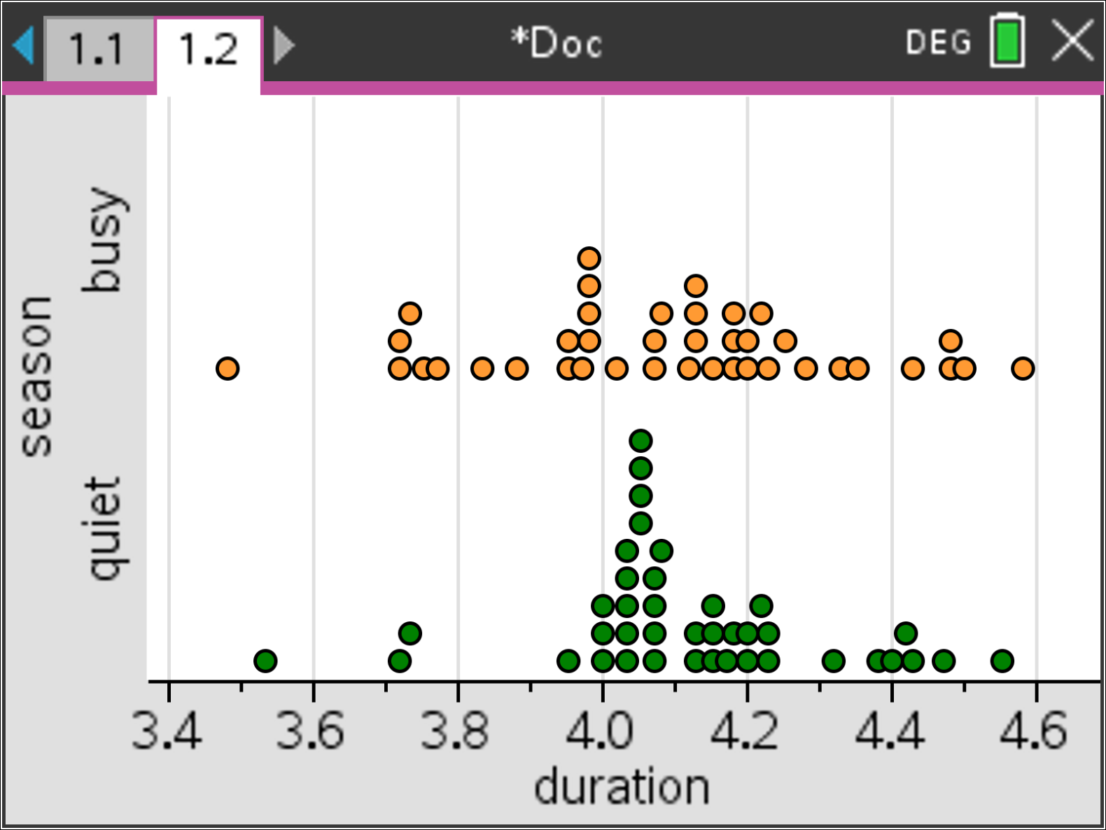
Graphing Data with a Categorical Grouping

Slide 16
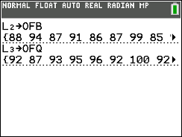
Old Faithful finale, part II
Do these data provide convincing evidence at the α = 0.05 significance level of a difference in the mean wait time for a subsequent Old Faithful eruption in busier and quieter months of 2019?
Busier months
88 | 94 | 87 | 91 | 86 | 87 | 99 | 85 | 91 | 98 | 99 | 86 | 96 | 96
100 | 97 | 93 | 93 | 100 | 95 | 90 | 96 | 90 | 96 | 98 | 93 | 100 | 90
92 | 92 | 95 | 99 | 95 | 95 | 87 | 98 | 95 | 97 | 96 | 99
Quieter months
92 | 87 | 93 | 95 | 96 | 92 | 100 | 92 | 92 | 96 | 97 | 92 | 99 | 99
91 | 89 | 101 | 98 | 88 | 96 | 99 | 96 | 96 | 90 | 92 | 87 | 86 | 93
97 | 89 | 98 | 88 | 102 | 97 | 94 | 102 | 97 | 101 | 98 | 95
$$H_{0}:μ_{B}−μ_{Q}=0$$
$$H_{a}:μ_{B}−μ_{Q}≠0$$
where $μ_{B}$ = mean wait time for a subsequent Old Faithful eruption in busier months and $μ_{Q}$ = mean wait time for a subsequent Old Faithful eruption in quieter months .
Use α = 0.05.

Slide 17
Old Faithful finale, part II
Do these data provide convincing evidence at the α = 0.05 significance level of a difference in the mean wait time for a subsequent Old Faithful eruption in busier and quieter months of 2019?
Busier months
88 | 94 | 87 | 91 | 86 | 87 | 99 | 85 | 91 | 98 | 99 | 86 | 96 | 96
100 | 97 | 93 | 93 | 100 | 95 | 90 | 96 | 90 | 96 | 98 | 93 | 100 | 90
92 | 92 | 95 | 99 | 95 | 95 | 87 | 98 | 95 | 97 | 96 | 99
Quieter months
92 | 87 | 93 | 95 | 96 | 92 | 100 | 92 | 92 | 96 | 97 | 92 | 99 | 99
91 | 89 | 101 | 98 | 88 | 96 | 99 | 96 | 96 | 90 | 92 | 87 | 86 | 93
97 | 89 | 98 | 88 | 102 | 97 | 94 | 102 | 97 | 101 | 98 | 95
Two-sample t test for a difference in means
Random? Separate random samples of 40 Old Faithful eruptions in busier months and 40 eruptions in quieter months.
10%? 40 ≤ 10%(all eruptions in busier months) and 40 ≤ 10%(all eruptions in busier months)
Normal/Large sample? $n_{B}=40≥30 and{ n}_{Q}=40≥30$

Slide 18
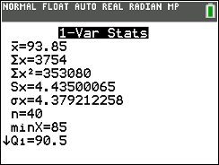
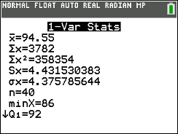
Old Faithful finale, part II
Do these data provide convincing evidence at the α = 0.05 significance level of a difference in the mean wait time for a subsequent Old Faithful eruption in busier and quieter months of 2019?
Busier months
88 | 94 | 87 | 91 | 86 | 87 | 99 | 85 | 91 | 98 | 99 | 86 | 96 | 96
100 | 97 | 93 | 93 | 100 | 95 | 90 | 96 | 90 | 96 | 98 | 93 | 100 | 90
92 | 92 | 95 | 99 | 95 | 95 | 87 | 98 | 95 | 97 | 96 | 99
Quieter months
92 | 87 | 93 | 95 | 96 | 92 | 100 | 92 | 92 | 96 | 97 | 92 | 99 | 99
91 | 89 | 101 | 98 | 88 | 96 | 99 | 96 | 96 | 90 | 92 | 87 | 86 | 93
97 | 89 | 98 | 88 | 102 | 97 | 94 | 102 | 97 | 101 | 98 | 95
$$t=\frac{\left({\overline{x}}_{B}−{\overline{x}}_{Q}\right)−0}{\sqrt{\frac{s_{B}^{2}}{n_{B}}+\frac{s_{Q}^{2}}{n_{Q}}}}=\frac{\left(94.55−93.85\right)−0}{\sqrt{\frac{{4.432}^{2}}{40}+\frac{{4.435}^{2}}{40}}}=−0.71$$
P-value = ?? Using df = ??

Slide 19
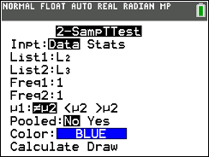
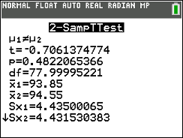
Old Faithful finale, part II
Do these data provide convincing evidence at the α = 0.05 significance level of a difference in the mean wait time for a subsequent Old Faithful eruption in busier and quieter months of 2019?
Busier months
88 | 94 | 87 | 91 | 86 | 87 | 99 | 85 | 91 | 98 | 99 | 86 | 96 | 96
100 | 97 | 93 | 93 | 100 | 95 | 90 | 96 | 90 | 96 | 98 | 93 | 100 | 90
92 | 92 | 95 | 99 | 95 | 95 | 87 | 98 | 95 | 97 | 96 | 99
Quieter months
92 | 87 | 93 | 95 | 96 | 92 | 100 | 92 | 92 | 96 | 97 | 92 | 99 | 99
91 | 89 | 101 | 98 | 88 | 96 | 99 | 96 | 96 | 90 | 92 | 87 | 86 | 93
97 | 89 | 98 | 88 | 102 | 97 | 94 | 102 | 97 | 101 | 98 | 95
$$t=\frac{\left({\overline{x}}_{B}−{\overline{x}}_{Q}\right)−0}{\sqrt{\frac{s_{B}^{2}}{n_{B}}+\frac{s_{Q}^{2}}{n_{Q}}}}=\frac{\left(94.55−93.85\right)−0}{\sqrt{\frac{{4.432}^{2}}{40}+\frac{{4.435}^{2}}{40}}}=−0.71$$
P-value = 0.4822 using df = 78.0

Slide 20
Old Faithful finale, part II
Do these data provide convincing evidence at the α = 0.05 significance level of a difference in the mean wait time for a subsequent Old Faithful eruption in busier and quieter months of 2019?
No. Because the P-value of 0.4822 > α = 0.05, we fail to reject H₀. The data do not provide convincing evidence of a difference in mean wait time for a subsequent Old Faithful eruption in busier and quieter months of 2019.

Slide 21
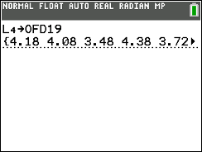
Old Faithful finale, part III
3. Here are data on the duration (in minutes) and the wait time until the next eruption (in minutes) for the random sample of 80 Old Faithful eruptions.
Duration | 4.18 | 4.08 | 3.48 | 4.38 | 3.72 | 4.32 | 4.13 | 4.5 | 4.05 | 3.88 | 4.07 | 4.18 | 4.12 | 4.03 | 3.98 | 3.72 | 4.15 | 4.07 | 4.23 | 4.07
Wait time | 93 | 99 | 88 | 94 | 87 | 97 | 96 | 96 | 99 | 85 | 96 | 100 | 95 | 97 | 100 | 94 | 92 | 93 | 95 | 93
Duration | 3.77 | 4.58 | 4.07 | 4 | 4.02 | 4.2 | 4.48 | 4.07 | 4.2 | 3.83 | 4.05 | 4.2 | 4.03 | 3.73 | 4.15 | 3.72 | 4.42 | 3.98 | 3.95 | 4.28
Wait time | 87 | 99 | 101 | 92 | 97 | 92 | 95 | 98 | 90 | 99 | 89 | 97 | 96 | 93 | 90 | 87 | 97 | 96 | 98 | 95
Duration | 4.13 | 4.18 | 4.2 | 4.13 | 3.97 | 4.15 | 4.13 | 4.22 | 4.18 | 3.95 | 3.95 | 4.17 | 4.22 | 4.03 | 4.47 | 4 | 3.73 | 4.03 | 4.03 | 4.33
Wait time | 96 | 93 | 89 | 96 | 99 | 87 | 90 | 92 | 98 | 91 | 95 | 86 | 98 | 92 | 98 | 100 | 91 | 92 | 92 | 95
Duration | 3.98 | 4.25 | 4.55 | 4.05 | 3.98 | 4.08 | 4.07 | 4.43 | 4.43 | 4.23 | 4.13 | 3.75 | 3.53 | 4.23 | 4.4 | 4.15 | 4.48 | 4 | 4.05 | 4.35
Wait time | 96 | 99 | 95 | 99 | 86 | 100 | 88 | 101 | 98 | 102 | 90 | 86 | 92 | 88 | 102 | 96 | 97 | 96 | 91 | 87
(a) Do these data provide convincing evidence of a positive, linear relationship between the duration of an Old Faithful eruption and the wait time until the next eruption in January-August 2019? Assume the conditions for inference are met.

Slide 22
Old Faithful finale, part III
(a) Do these data provide convincing evidence of a positive, linear relationship between the duration of an Old Faithful eruption and the wait time until the next eruption in January-August 2019? Assume the conditions for inference are met.
Duration | 4.18 | 4.08 | 3.48 | 4.38 | 3.72 | 4.32 | 4.13 | 4.5 | 4.05 | 3.88 | 4.07 | 4.18 | 4.12 | 4.03 | 3.98 | 3.72 | 4.15 | 4.07 | 4.23 | 4.07
Wait time | 93 | 99 | 88 | 94 | 87 | 97 | 96 | 96 | 99 | 85 | 96 | 100 | 95 | 97 | 100 | 94 | 92 | 93 | 95 | 93
Duration | 3.77 | 4.58 | 4.07 | 4 | 4.02 | 4.2 | 4.48 | 4.07 | 4.2 | 3.83 | 4.05 | 4.2 | 4.03 | 3.73 | 4.15 | 3.72 | 4.42 | 3.98 | 3.95 | 4.28
Wait time | 87 | 99 | 101 | 92 | 97 | 92 | 95 | 98 | 90 | 99 | 89 | 97 | 96 | 93 | 90 | 87 | 97 | 96 | 98 | 95
Duration | 4.13 | 4.18 | 4.2 | 4.13 | 3.97 | 4.15 | 4.13 | 4.22 | 4.18 | 3.95 | 3.95 | 4.17 | 4.22 | 4.03 | 4.47 | 4 | 3.73 | 4.03 | 4.03 | 4.33
Wait time | 96 | 93 | 89 | 96 | 99 | 87 | 90 | 92 | 98 | 91 | 95 | 86 | 98 | 92 | 98 | 100 | 91 | 92 | 92 | 95
Duration | 3.98 | 4.25 | 4.55 | 4.05 | 3.98 | 4.08 | 4.07 | 4.43 | 4.43 | 4.23 | 4.13 | 3.75 | 3.53 | 4.23 | 4.4 | 4.15 | 4.48 | 4 | 4.05 | 4.35
Wait time | 96 | 99 | 95 | 99 | 86 | 100 | 88 | 101 | 98 | 102 | 90 | 86 | 92 | 88 | 102 | 96 | 97 | 96 | 91 | 87
$$H_{0}:β=0$$
$$H_{a}:β>0$$
where $β$= slope of the population regression line for predicting wait time until the next Old Faithful eruption from the duration of the previous eruption.
Use α = 0.05.

Slide 23
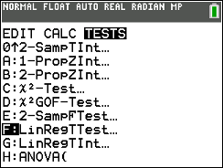
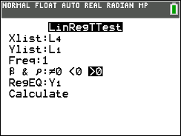
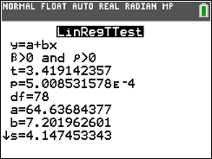
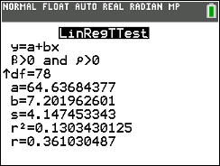
Old Faithful finale, part III
(a) Do these data provide convincing evidence of a positive, linear relationship between the duration of an Old Faithful eruption and the wait time until the next eruption in January-August 2019? Assume the conditions for inference are met.
t test for slope; conditions are met
t = 3.419
P-value = 0.0005 using df = 80 – 2 = 78

Slide 24
Old Faithful finale, part III
(a) Do these data provide convincing evidence of a positive, linear relationship between the duration of an Old Faithful eruption and the wait time until the next eruption in January-August 2019? Assume the conditions for inference are met.
t test for slope; conditions are met
t = 3.419
P-value = 0.0005 using df = 80 – 2 = 78
Yes. Because the P-value of 0.0005 < α = 0.05, we reject H₀. The data do provide convincing evidence of a positive, linear relationship between the duration of an Old Faithful eruption and the wait time until the next eruption in January-August 2019.

Slide 25
Old Faithful finale, part III
(b) A 90% confidence interval for the slope of the population regression line for predicting wait time from duration of the previous Old Faithful eruption in January-August 2019 is 3.696 to 10.708. Explain why this interval is consistent with, but gives more information than, the significance test in part (a).
The 90% confidence interval tells us that the believable values for the slope of the population regression line for predicting the wait time until the next eruption of Old Faithful from the duration of the previous eruption is between 3.696 and 10.708—all positive values. This is consistent with our decision in part (a) that there is convincing evidence that the slope of the population regression line is positive. But the interval provides more information: the set of positive slopes that are believable based on the sample data.

Slide 26
The handout and slides will be posted
<https://education.ti.com/en/bulletinboard/statisticsofficehours>.
Questions?
Enter them in the chat and we’ll get to as many
as we can!

